Slide 2
Ant sorting
Menno Van Damme, Yari Van Laere

Slide 3



Lumer-faieta

Slide 4
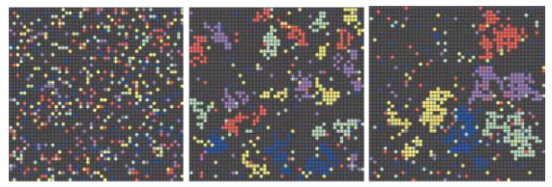
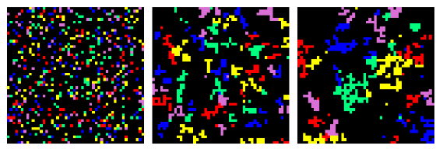
Results Lumer-Faieta
0
10 000
100 000

Slide 5
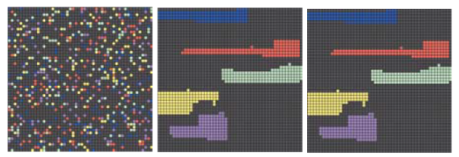

Results with clustering
0
10 000
100 000

Slide 6
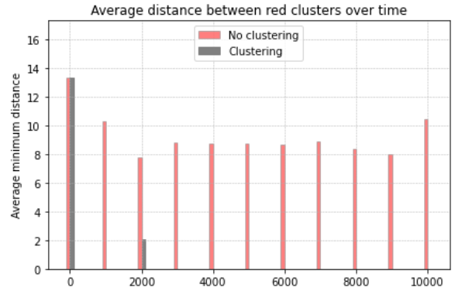
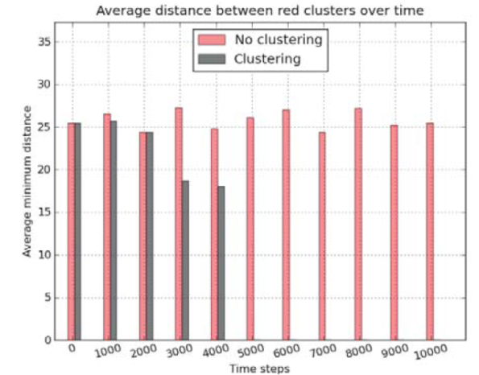
comparison

Slide 7
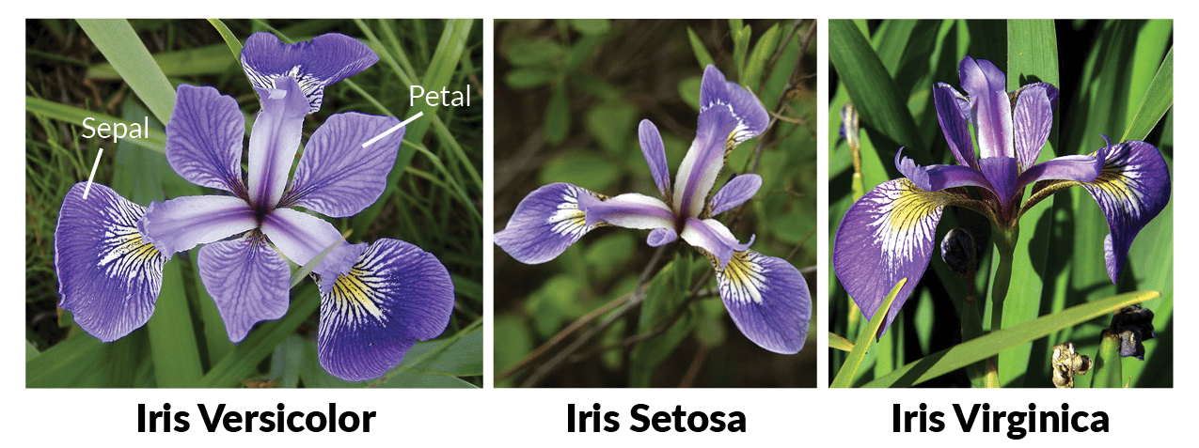
Continuous vector sorting

Slide 8


Dissimilarity

Slide 9
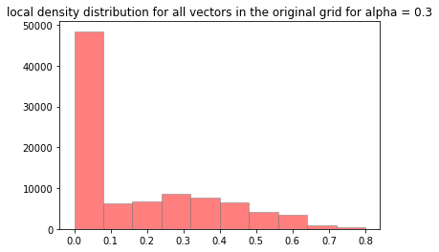
Alpha

Slide 10
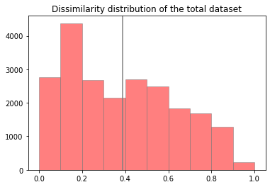
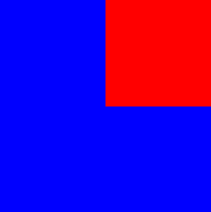
Clustering

Slide 11
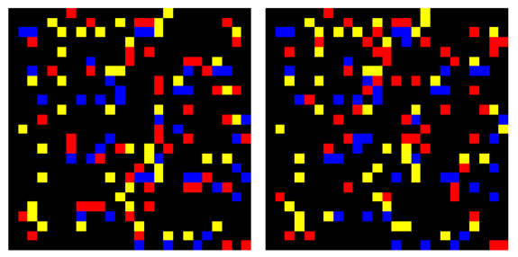
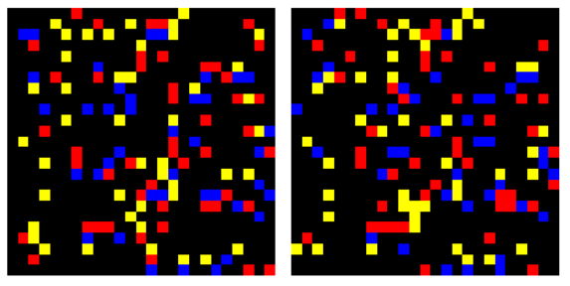
results
Lumer-Faieta without clustering
0
1 000 000
Lumer-Faieta with clustering
0
10 000

Slide 12
